Slide 1

Spring 3.0 New Features
Blesson John Abraham
245045

Slide 2
Spring 3.0
Spring is a popular open-source framework for building enterprise Java applications.
Simplify Java development: Spring aims to simplify Java development by providing a cohesive framework with a consistent programming model.
Spring 3.0 was a major release of the framework, introducing several new features and improvements.
Spring Boot 3.0 was released on November 2022

Slide 3
New Features
Java 17 support
Jakarta
Spring Native
Observability
Problem Detail
Dependency Upgrade
@HttpExchange

Slide 4
Jakarta
Java 17 support
Minimum java 17 is needed
All the features of java 17 can be used
Records ,Switch ,
Only support JakartaEE9 (minimum)
Servlet 5.0 and jpa 3.0 specification
Problem Detail
Deals with http specific errors
Maps with http status

Slide 5
Observability
Publish our matrix so that it can be easily tracked
Zipkin, Promethues, Graphina
Observations is used
Spring Native
Compile Spring applications into locally executable image files
It supports using GraalVM
Significantly improve start-up speed
Improves peak performance
Reduce memory usage.
Traditional applications are compiled into bytecode, then interpreted by, JVM and finally compiled into machine code to run
Spring Native is compiled into machine code in advance through AOT
Statically compiled into executable files directly at runtime

Slide 6
Dependency upgrade
Kotlin 1.7+
Lombok 1.18.22+ (JDK17 support version)
@Httpexchange
Native support for declarative http client interface
@GetExchange
@PostExchange
@PutExchange
@DeleteExchange

Slide 7
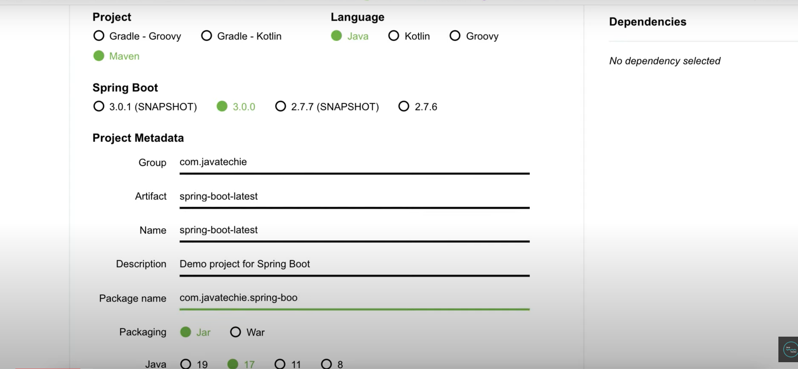

Slide 8
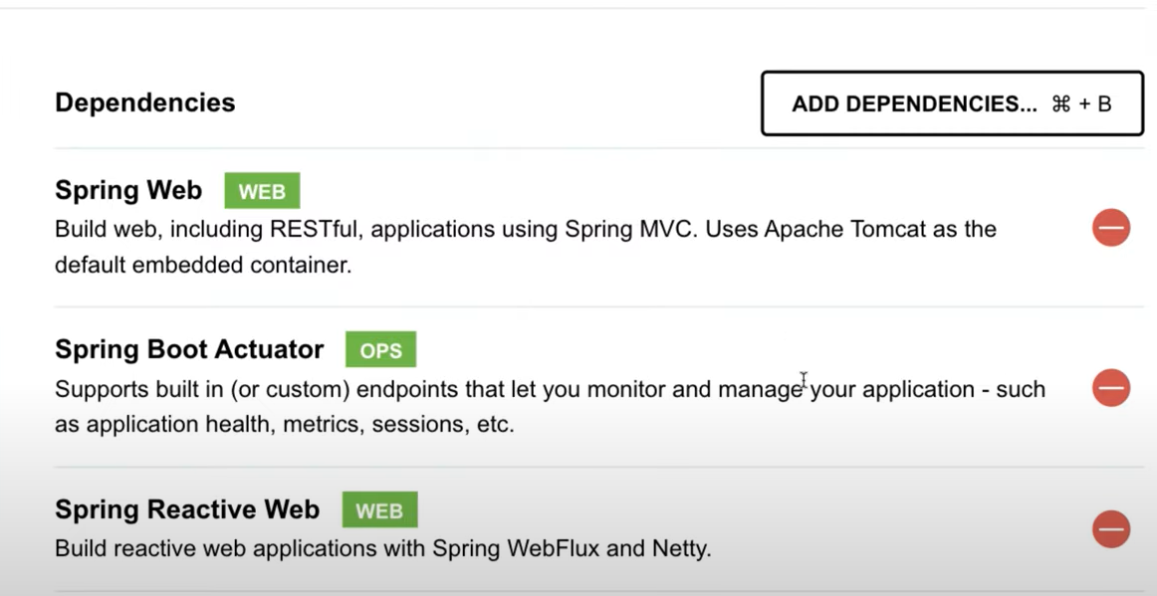

Slide 9
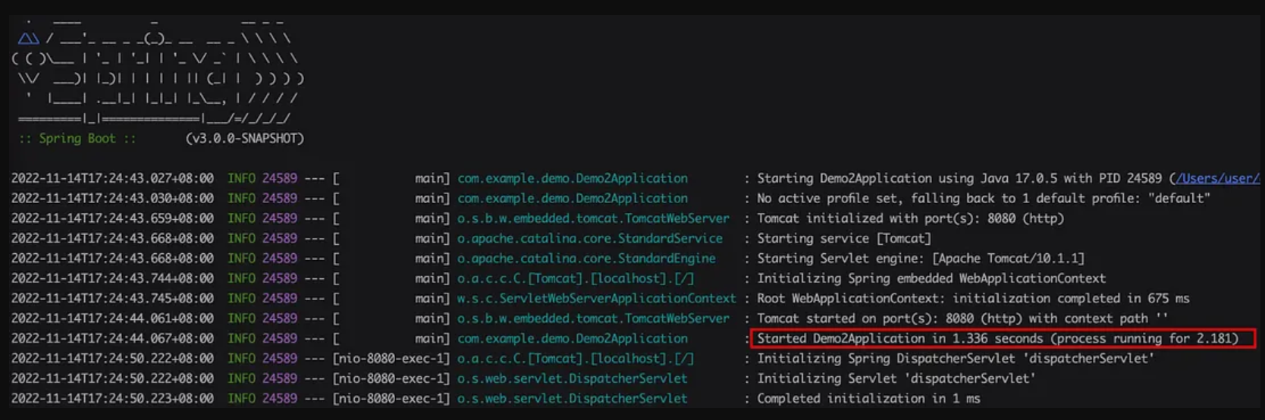

Slide 10
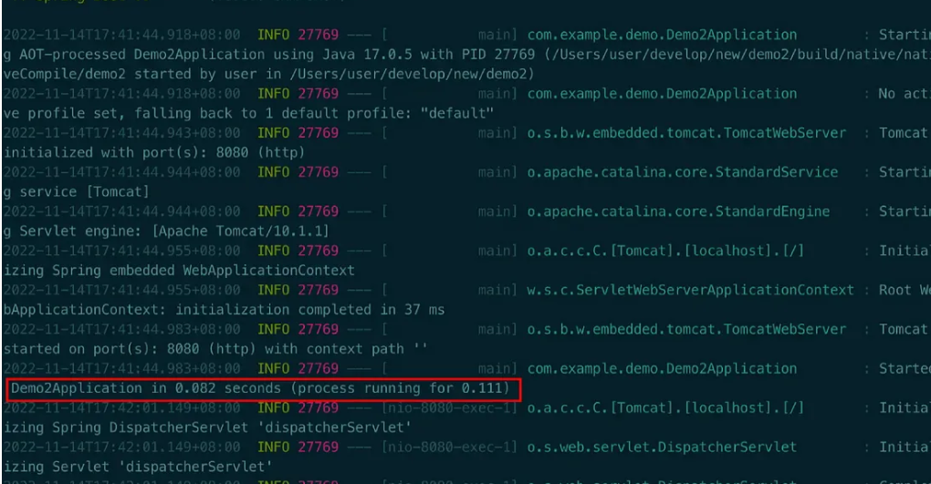

Slide 11
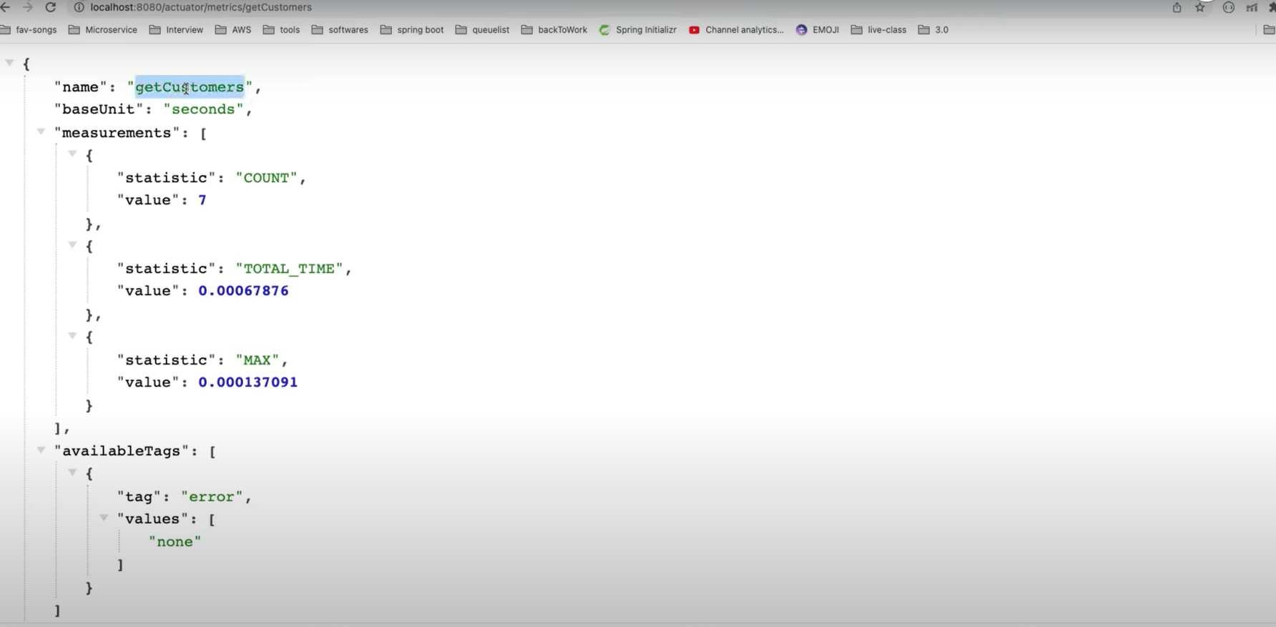

Slide 12
References
https://github.com/BLESSON-UST/Advance/tree/main/spring-boot-3.0-main
https://www.youtube.com/watch?v=4_jey1hfEw0

